Slide 1
Transformers – Encoder Layer
By
Srinivas Rahul Sapireddy

Slide 2
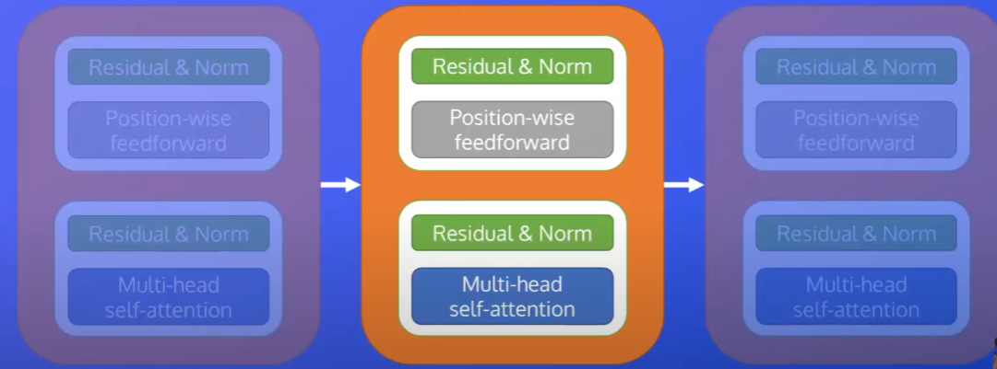
Encoder Layer C onnections

